Slide 1


Reporting under the adapted Governance Regulation –
Introduction
National Training in Bosnia and Herzegovina
7-9 October 2025
Sarajevo, Bosnia and Herzegovina
In-person training
© Wolf-Dietrich Hufenbach, Environment&Me 2025 / EEA

Slide 2
Session outline
1. Tour de table – who’s in the room
2. The adapted Governance Regulation
Overview of reporting obligations
Institutional set-up and roles
Quality control process
3. Reporting platform: Reportnet 3
4. Import/Export functionality – coherence with UNFCCC reporting
© Wolf-Dietrich Hufenbach, Environment&Me 2025 / EEA

Slide 3




Tour de table – Who’s who?
Please introduce yourself with:
Your name
Your institution
Your experience with climate and energy reporting
Your favorite month of the year

Slide 4

The Governance Regulation

Slide 5


The Governance Regulation
The Governance Regulation (GovReg), in force since 2018, builds on previous pieces of legislation (the Monitoring Mechanism Regulation (MMR), which replaced the Monitoring Mechanism Decision (MMD)).
The GovReg stands on two legs: one planning and one reporting leg.
Legal basis: Governance Regulation 2018/1999, and its two Implementing Regulations 2020/1208 and 2022/2299.
Planning: The EU 27 Member States have prepared and submitted their National Energy and Climate Plans (NECPs). The first drafts were due in 2018, and they were updated in 2023.
Reporting: Every two years, the MS submit progress reports towards their NECPs. These are the National Energy and Climate Progress Reports (NECPRs).
Notes:
For the Energy Community’s CPs, the adapted Governance Regulation sets common rules for planning, reporting and monitoring on energy and climate policies and targets, including via National Energy and Climate Plans. Targeted support is needed to ensure compliance, e.g. the quality of reported data, its comparability with EU data, and its appropriate compilation and analysis. The reporting requirements come gradually, with the first new obligations being introduced in 2023. These include reporting on national greenhouse gas policies and measures, national climate change adaptation planning and strategies, and the description of the national system for reporting on policies and measures and projections of anthropogenic GHG emissions. This will be expanded to include numerous data flows, including the greenhouse gas inventories and information on support to developing countries.
The nine CPs are the six West Balkan CPs of Albania, Bosnia and Herzegovina, North Macedonia, Kosovo, Montenegro, and Serbia, as well as the three Eastern Partnership members of the Energy Community: Georgia, the Republic of Moldova and Ukraine. The project includes both virtual and in-person training sessions where the targeted technical assistance will be provided.
A key partner of this community is the Energy Community Secretariat, which is coordinating the full scope of reporting under the adapted Governance Regulation and which will collect all final data sets for further communication. Moreover, the Secretariat is a key partner in the coordination of technical assistance of the project and aligning it with the broader support provided by the Energy Community Secretariat.

Slide 6
The adapted Governance Regulation
The Ministerial Council of the Energy Community on 30 November 2021 adapted and incorporated the GovReg in the acquis Communautaire.
Gradual implementation, with the first reporting obligations entering in 2023. The draft Integrated NECPs were due on the 30 June 2023.
.
Notes:
For the Energy Community’s CPs, the adapted Governance Regulation sets common rules for planning, reporting and monitoring on energy and climate policies and targets, including via National Energy and Climate Plans. Targeted support is needed to ensure compliance, e.g. the quality of reported data, its comparability with EU data, and its appropriate compilation and analysis. The reporting requirements come gradually, with the first new obligations being introduced in 2023. These include reporting on national greenhouse gas policies and measures, national climate change adaptation planning and strategies, and the description of the national system for reporting on policies and measures and projections of anthropogenic GHG emissions. This will be expanded to include numerous data flows, including the greenhouse gas inventories and information on support to developing countries.
The nine CPs are the six West Balkan CPs of Albania, Bosnia and Herzegovina, North Macedonia, Kosovo, Montenegro, and Serbia, as well as the three Eastern Partnership members of the Energy Community: Georgia, the Republic of Moldova and Ukraine. The project includes both virtual and in-person training sessions where the targeted technical assistance will be provided.
A key partner of this community is the Energy Community Secretariat, which is coordinating the full scope of reporting under the adapted Governance Regulation and which will collect all final data sets for further communication. Moreover, the Secretariat is a key partner in the coordination of technical assistance of the project and aligning it with the broader support provided by the Energy Community Secretariat.

Slide 7
The adapted Governance Regulation
End of 2024:
UNFCCC BTR deadline
2023
2025
GHG Inventory 15 January: Draft GHG Inventory
15 March: Final GHG Inventory
31 July: Approximated Inventory
Mitigation
15 March: GHG Policies and Measures (PaMs)& reporting on the National System
Mitigation
15 March: Integrated Policies and Measures (PaMs)
15 March: Greenhouse gas projections
15 March: NECPR reporting within GHG, RES, and EE
15 March: Additional reporting on RES and EE
Adaptation
15 March: National adaptation plans and strategies
Adaptation
15 March: National adaptation plans and strategies
15 March: NECPR reporting within adaptation
Climate Finance
31 July: Use of any revenues generated from carbon price mechanisms
Climate Finance
31 July: Use of any revenues generated from carbon price mechanisms
30 September: Support provided to developing countries
Notes:
Looking past 2025, we need to look at the reporting calendar.
2026 – not an intense reporting year in terms of GovReg data. However the inventory and the financial data needs to be reported. And this is the first year that this need to be reported without the BTR funds being available just before, as the BTR deadline is first in the end of that year.
Underlines the importance of creating a GHG Inventory system that is able to generate this once per year.
2027 – this is an intense year. The same reporting that you have done this year comes again. Having gone through the QC process, and with the pre-loading of existing data, this will significantly speed up the process.
The Comprehensive Review on the GHG Inventory – as the name implies, this is a more comprehensive review of the GHG Inventories. Again, very useful, but will demand time from your inventory teams.

Slide 8
Reporting obligations beyond 2025
2026
2027
GHG Inventory 15 January: Draft GHG Inventory
15 March: Final GHG Inventory
31 July: Approximated Inventory
GHG Inventory 15 January: Draft GHG Inventory
15 March: Final GHG Inventory
31 July: Approximated Inventory
+ Comprehensive Review
Climate Finance
31 July: Use of any revenues generated from carbon price mechanisms
30 September: Support provided to developing countries
Mitigation
15 March: Integrated Policies and Measures (PaMs)
15 March: Greenhouse gas projections
15 March: NECPR reporting within GHG, RES, and EE
15 March: Additional reporting on RES and EE
Adaptation
15 March: National adaptation plans and strategies
15 March: NECPR reporting within adaptation
End of 2026:
UNFCCC BTR deadline
Climate Finance
31 July: Use of any revenues generated from carbon price mechanisms
30 September: Support provided to developing countries
Notes:
Looking past 2025, we need to look at the reporting calendar.
2026 – not an intense reporting year in terms of GovReg data. However the inventory and the financial data needs to be reported. And this is the first year that this need to be reported without the BTR funds being available just before, as the BTR deadline is first in the end of that year.
Underlines the importance of creating a GHG Inventory system that is able to generate this once per year.
2027 – this is an intense year. The same reporting that you have done this year comes again. Having gone through the QC process, and with the pre-loading of existing data, this will significantly speed up the process.
The Comprehensive Review on the GHG Inventory – as the name implies, this is a more comprehensive review of the GHG Inventories. Again, very useful, but will demand time from your inventory teams.

Slide 9
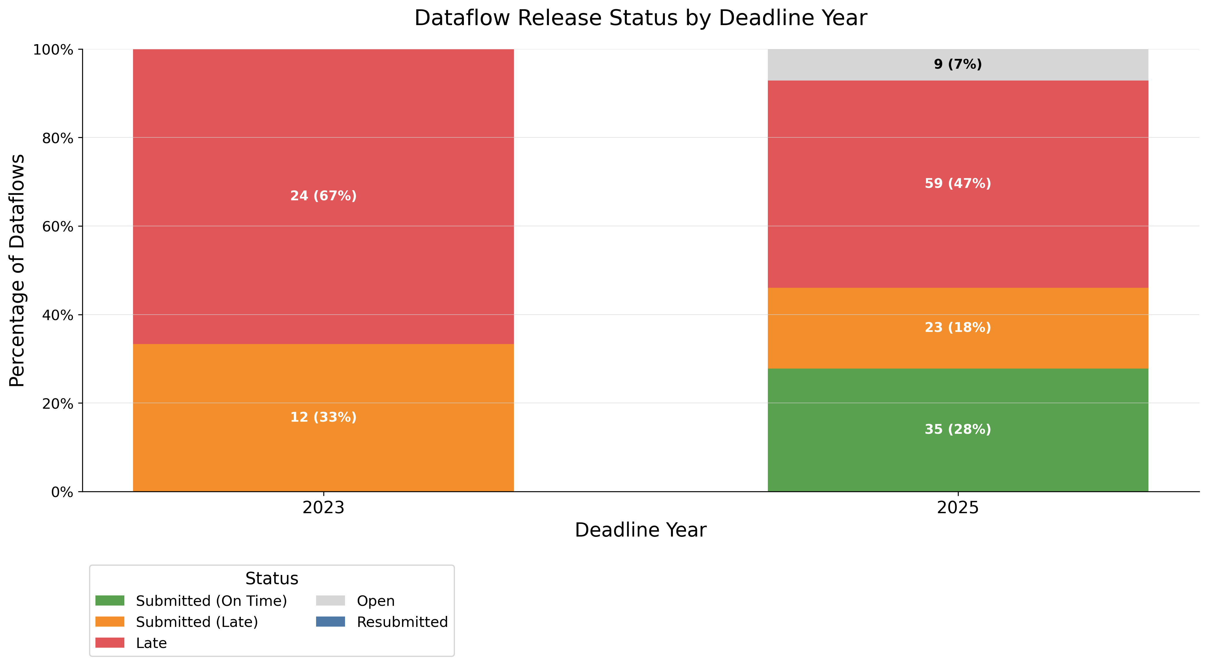
REPORTING SUBMISSION BREAKDOWN
Notes:
This chart shows the percentage of submissions (on time, late, and not submitted) by deadline. The width of each silo's base is proportional to the number of dataflows associated with that deadline, visually reflecting the reporting load.
There is a notable increase in on-time submissions (green bars) in recent deadlines — a positive trend that should be reinforced.

Slide 10
TIMELINE FOR THE REPORTING OBLIGATIONS
January
February
March
April
May
June
July
August
September
October
Draft GHG Inventory, X-2
GHG Inventory, X-2
Approximated GHG Inventory.
X-1
GHG Integrated Policies and Measures
Adaptation Planning and Strategies National systems
Legend:
Existing Obligations
Progress to targets adaptation
Progress to targets GHG
Progress to targets RES
Progress to targets EE
Dataflow opens
Deadline dataflow
New Obligations
Additional RES
Additional EE
GHG Projections
Revenues from Carbon Price Mechanisms
Supp. Dev. Countries

Slide 11
Overview of roles and responsibilities
Nationally nominated from the Permanent High Level Representative to the Energy Community
Technical issues
Data Custodian
Energy Community Secretariat
Lead Reporter(s)
Data Stewards
Thematic topics
Supporting Reporters
Notes:
For the Energy Community’s CPs, the adapted Governance Regulation sets common rules for planning, reporting and monitoring on energy and climate policies and targets, including via National Energy and Climate Plans. Targeted support is needed to ensure compliance, e.g. the quality of reported data, its comparability with EU data, and its appropriate compilation and analysis. The reporting requirements come gradually, with the first new obligations being introduced in 2023. These include reporting on national greenhouse gas policies and measures, national climate change adaptation planning and strategies, and the description of the national system for reporting on policies and measures and projections of anthropogenic GHG emissions. This will be expanded to include numerous data flows, including the greenhouse gas inventories and information on support to developing countries.
The nine CPs are the six West Balkan CPs of Albania, Bosnia and Herzegovina, North Macedonia, Kosovo, Montenegro, and Serbia, as well as the three Eastern Partnership members of the Energy Community: Georgia, the Republic of Moldova and Ukraine. The project includes both virtual and in-person training sessions where the targeted technical assistance will be provided.
A key partner of this community is the Energy Community Secretariat, which is coordinating the full scope of reporting under the adapted Governance Regulation and which will collect all final data sets for further communication. Moreover, the Secretariat is a key partner in the coordination of technical assistance of the project and aligning it with the broader support provided by the Energy Community Secretariat.

Slide 12
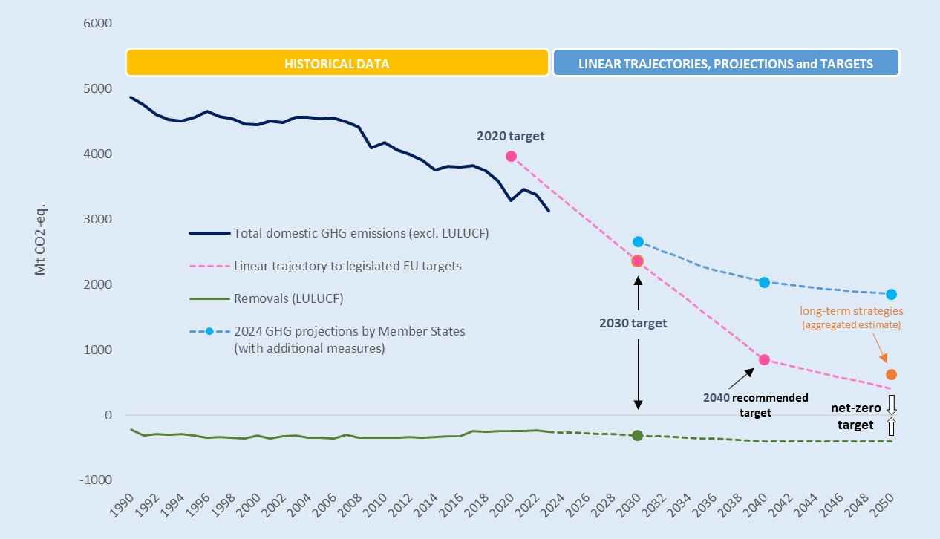
How is the reported data used
GHG projections and PaMs
GHG inventory
nLTS and NECPr
GHG approximated
Notes:
For the Energy Community’s CPs, the adapted Governance Regulation sets common rules for planning, reporting and monitoring on energy and climate policies and targets, including via National Energy and Climate Plans. Targeted support is needed to ensure compliance, e.g. the quality of reported data, its comparability with EU data, and its appropriate compilation and analysis. The reporting requirements come gradually, with the first new obligations being introduced in 2023. These include reporting on national greenhouse gas policies and measures, national climate change adaptation planning and strategies, and the description of the national system for reporting on policies and measures and projections of anthropogenic GHG emissions. This will be expanded to include numerous data flows, including the greenhouse gas inventories and information on support to developing countries.
The nine CPs are the six West Balkan CPs of Albania, Bosnia and Herzegovina, North Macedonia, Kosovo, Montenegro, and Serbia, as well as the three Eastern Partnership members of the Energy Community: Georgia, the Republic of Moldova and Ukraine. The project includes both virtual and in-person training sessions where the targeted technical assistance will be provided.
A key partner of this community is the Energy Community Secretariat, which is coordinating the full scope of reporting under the adapted Governance Regulation and which will collect all final data sets for further communication. Moreover, the Secretariat is a key partner in the coordination of technical assistance of the project and aligning it with the broader support provided by the Energy Community Secretariat.

Slide 13
The reporting process
Nomination of Lead Reporters
Reportnet open for submission
Quality control process
Nominations to EnCS
EEA grants access to Reportnet
EU Login
Opened from the beginning of March
Conducted at EEA
Aim is to complement and improve, not to find errors
Dialogue between the EEA and CPs
Will not close for submissions
Re-submissions possible
Lead reporters coordinate with supporting reporters
Notes:
For the Energy Community’s CPs, the adapted Governance Regulation sets common rules for planning, reporting and monitoring on energy and climate policies and targets, including via National Energy and Climate Plans. Targeted support is needed to ensure compliance, e.g. the quality of reported data, its comparability with EU data, and its appropriate compilation and analysis. The reporting requirements come gradually, with the first new obligations being introduced in 2023. These include reporting on national greenhouse gas policies and measures, national climate change adaptation planning and strategies, and the description of the national system for reporting on policies and measures and projections of anthropogenic GHG emissions. This will be expanded to include numerous data flows, including the greenhouse gas inventories and information on support to developing countries.
The nine CPs are the six West Balkan CPs of Albania, Bosnia and Herzegovina, North Macedonia, Kosovo, Montenegro, and Serbia, as well as the three Eastern Partnership members of the Energy Community: Georgia, the Republic of Moldova and Ukraine. The project includes both virtual and in-person training sessions where the targeted technical assistance will be provided.
A key partner of this community is the Energy Community Secretariat, which is coordinating the full scope of reporting under the adapted Governance Regulation and which will collect all final data sets for further communication. Moreover, the Secretariat is a key partner in the coordination of technical assistance of the project and aligning it with the broader support provided by the Energy Community Secretariat.

Slide 14
The QA/QC process
CPs Guidelines and training
E-mail/Excel file used to keep track of exchanges
1
CPs Guidelines and training
2
3
Manual QAQC
Notes:
SO: How do we plan and conduct QA/QC on data we receive from you ?
General schema applicable to all the dataflows and data type (textual or numerical):
Three steps to ensure better quality :
Upstream action: guidelines and training
Automatic QA/QC in Reportnet 3: Embedded in the system: Blockers, warning, errors =>
Manual QA/QC after release: human eye to validate the data => perhaps everything is perfect

Slide 15
Various dataflows – Various processes
The QA/QC process: - Helps you improve the quality of your data and hence the quality of the Energy Community level data (and beyond) - Contributes to the transparency objective - Supports the improvement of the process
The QA/QC process: Common principles but specific to each type of
data and dataflow.
Notes:
All what was said before is the general framework we apply
To recap; the intention is:
the intention is to help you improving the quality of your data => EU data and world level environmental information – Of very crucial importance in the context of such a glaobal env issue like climate change
Contribution to transparency
Improve the quality of the processes
BUT: Each dataflow is specific and requires specific QA/QC

Slide 16
Synergies with UNFCCC reporting
High level of reporting synergies
Integrated policies and measures (PaMs)
Adaptation planning and strategies
Potential reporting synergies
Description of national systems for mitigation actions and projections
Progress to targets (EE)
GHG Projections
Progress to targets (Adaptation)
Progress to targets (GHG)
Progress to targets (RES)
GHG inventory
(X-2)
Support to dev. countries
Lower level of reporting synergies
Use of revenues from carbon price mechanisms
Additional reporting obligations (RES)
Additional reporting obligations (EE)
Approximated GHG inventory (X-1)
Mitigation
Adaptation
Climate finance
Institutional arrangements
Notes:
For the Energy Community’s CPs, the adapted Governance Regulation sets common rules for planning, reporting and monitoring on energy and climate policies and targets, including via National Energy and Climate Plans. Targeted support is needed to ensure compliance, e.g. the quality of reported data, its comparability with EU data, and its appropriate compilation and analysis. The reporting requirements come gradually, with the first new obligations being introduced in 2023. These include reporting on national greenhouse gas policies and measures, national climate change adaptation planning and strategies, and the description of the national system for reporting on policies and measures and projections of anthropogenic GHG emissions. This will be expanded to include numerous data flows, including the greenhouse gas inventories and information on support to developing countries.
The nine CPs are the six West Balkan CPs of Albania, Bosnia and Herzegovina, North Macedonia, Kosovo, Montenegro, and Serbia, as well as the three Eastern Partnership members of the Energy Community: Georgia, the Republic of Moldova and Ukraine. The project includes both virtual and in-person training sessions where the targeted technical assistance will be provided.
A key partner of this community is the Energy Community Secretariat, which is coordinating the full scope of reporting under the adapted Governance Regulation and which will collect all final data sets for further communication. Moreover, the Secretariat is a key partner in the coordination of technical assistance of the project and aligning it with the broader support provided by the Energy Community Secretariat.

